Slide 1
Fall 2020
Midterm Exam

Slide 2
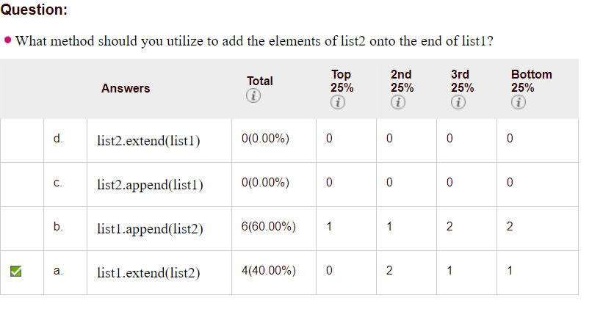

Slide 3
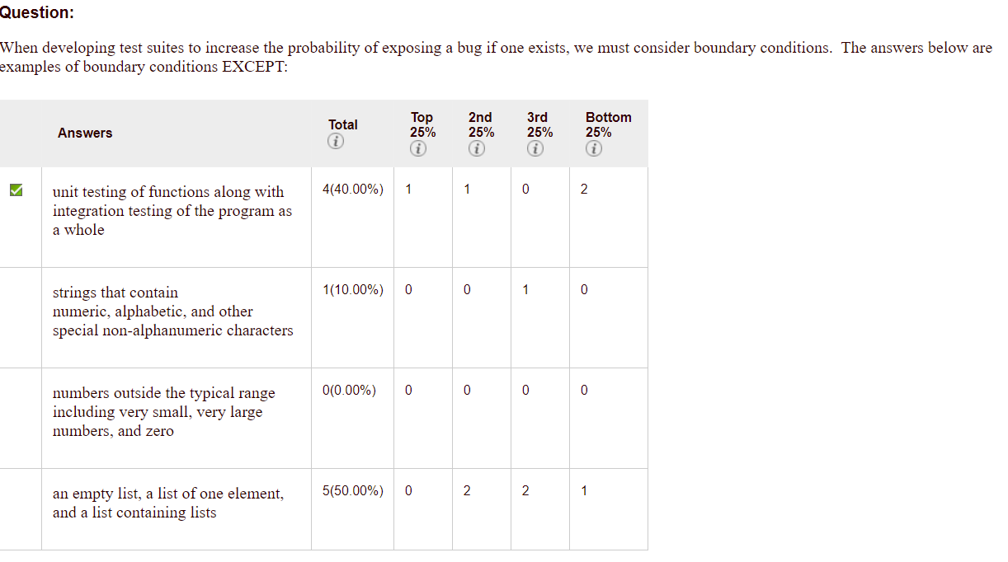

Slide 4
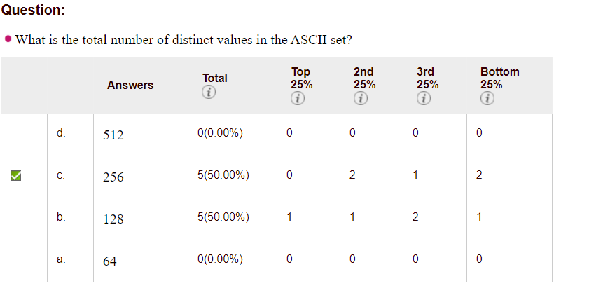

Slide 5
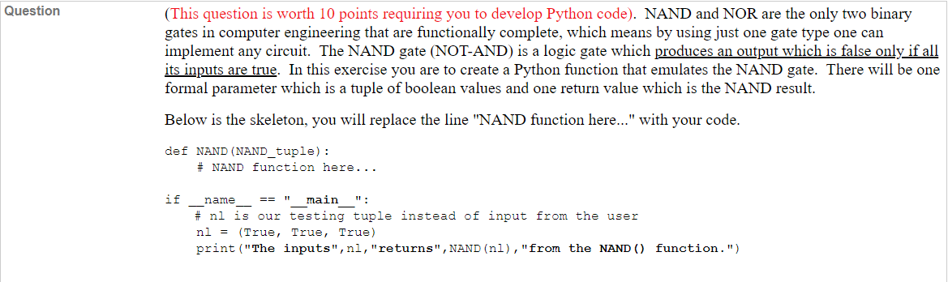

Slide 6
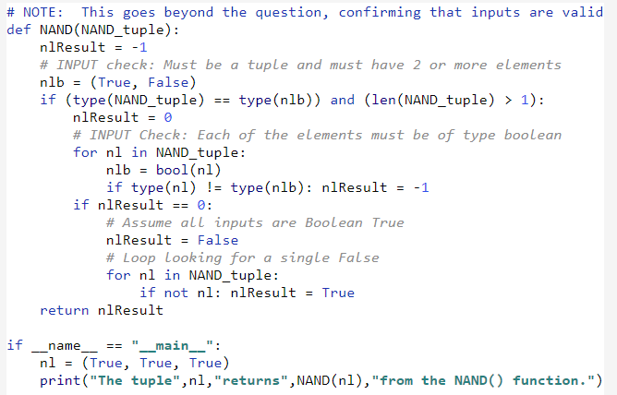

Slide 7
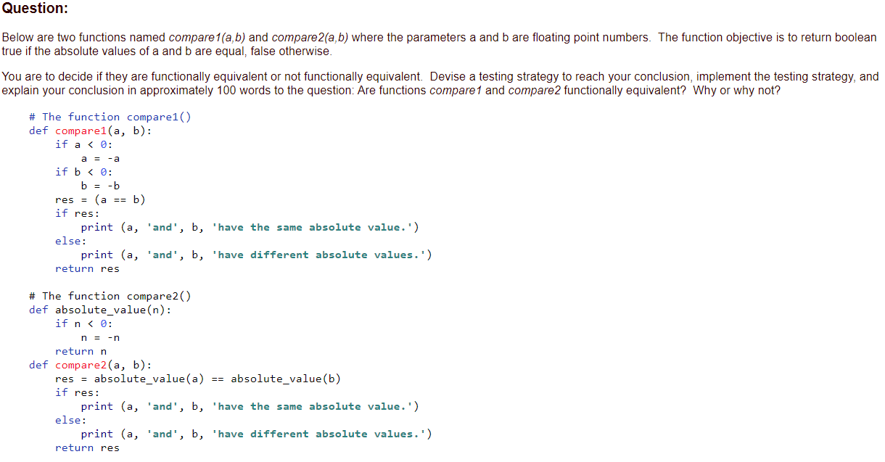

Slide 8
compare1(1.0, -1.0)
compare2(1.0, -1.0)
1.0 and 1.0 have the same absolute value.
1.0 and -1.0 have the same absolute value.
The two functions are not functionally equivalent. Both functions do return the correct boolean value as to whether the two inputs have the same absolute value. However, the functions print different results if one or both of the arguments provided are negative numbers. The reason for this is because of variable scoping. In compare1, all the variables are within the function and therefore in the same scope. In compare2, the value gets negated within the scope of the other function absolute_value, so the variables a and b in compare2 are not explicitly made positive because of scoping rules.

Slide 9
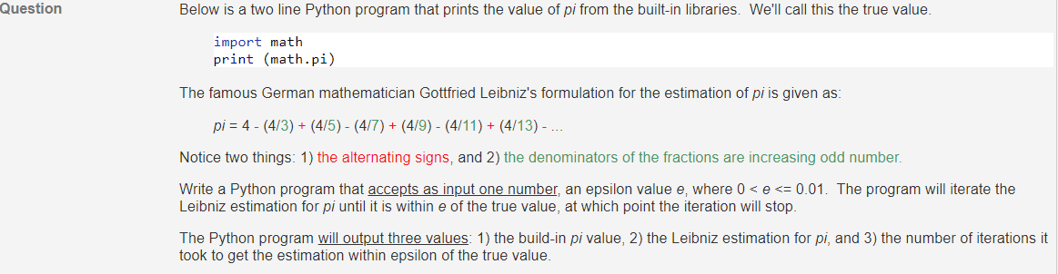

Slide 10
# Using Leibniz estimation, find pi within epsilon of the true value
# pi = 4 - (4/3) + (4/5) - (4/7) + (4/9) - (4/11) + (4/13) - ...
import math
e = float(input("Enter epsilon for Leibniz estimation for pi: "))
n = 0
if 0 < e <= 0.01:
estimation = 0
while abs(math.pi - estimation) >= e:
estimation = estimation + (4 * (((-1) ** n) / ((2 * n) + 1)))
n += 1
print("True value of pi: ", math.pi)
print("Leibniz estimation of pi: ", estimation)
print("Number of iterations: ", n)
else:
print("ERROR: 0 < epsilon <= 0.01")

